Slide 1
Advancing Healthcare Inclusion & Equal Treatment for People with Intellectual Disabilities Conference
26 November 2024
European Economic and Social Committee

Slide 2
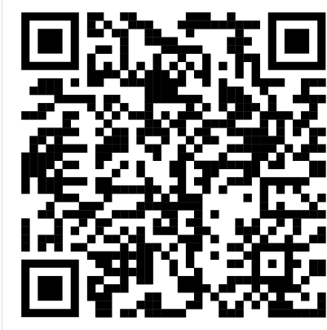
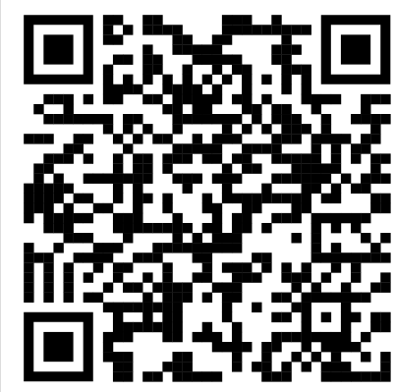
Equal Treatment online courses at the DigiCampus platform
To see the material go to the website: digicampus.fi
→ Log in → Access as a guest
For healthcare professionals:
For professional supporters:
26.11.2024

Slide 3
The online courses are available in 6 different languages in DigiCampus
Greek
Finnish
Lithuanian
Catalan
Spanish
Use the search bar at the top of the DigiCampus webpage

