Slide 1
The Cedar Foundation
Rosie McNaughton
Head of Community Inclusion Services

Slide 2
Introduction to The Cedar Foundation
Established in 1941
Registered Charity & Company Limited by Guarantee
Services for people with Disability, Brain Injury and Autism
Regional Organisation / 22 service locations
350 Staff
2,000 Service Users
Notes:
Before I begin, let me put some things in context for you.
In Northern Irish terms Cedar is quite an old organisation. We were established in 1941 as the Northern Ireland Council on Orthopedic Development prior to the establishment of the NHS. We set up the first special schools in Northern Ireland and established the first dedicated vocational services for people with disability.
We remain a registered charity and are also a company limited by Guarantee.
We provide services – Training, Brain Injury, Children and Young People and Living Options - for people with an increasing range and complexity of disabilities across 22 service locations.
We employ around 250 people to deliver services to around 1600 people each year.

Slide 3
Vision
Mission
Values

Slide 4
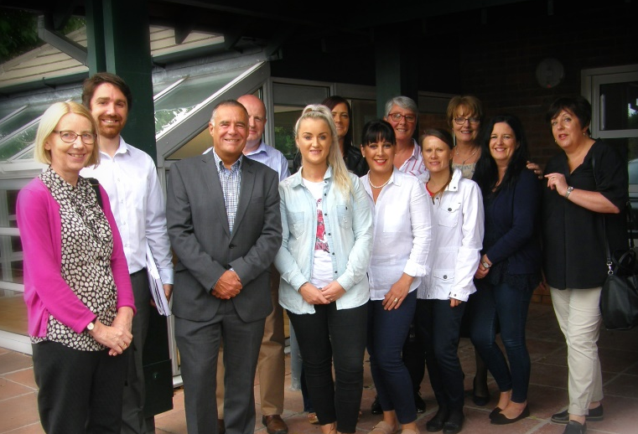
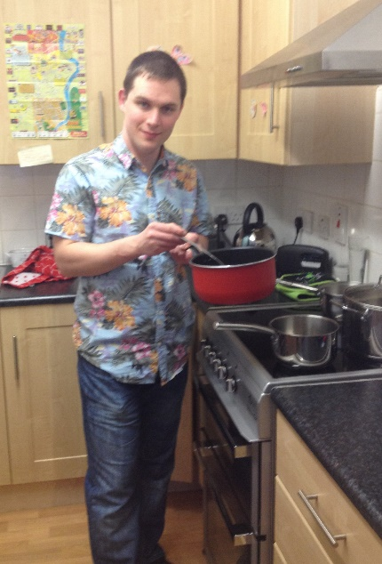
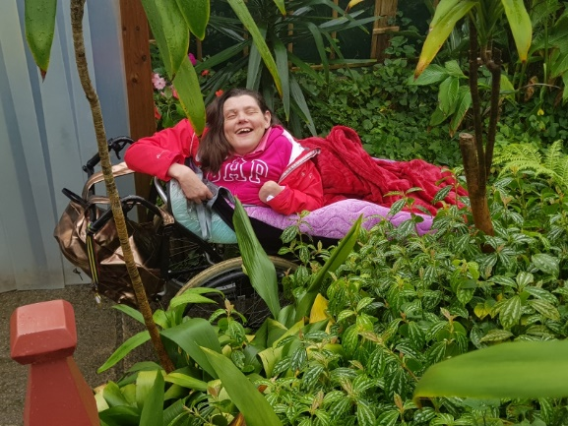
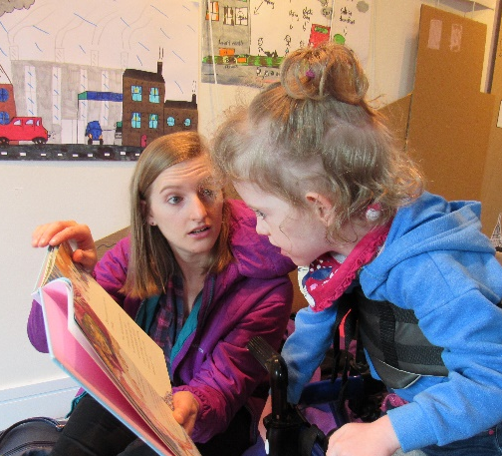
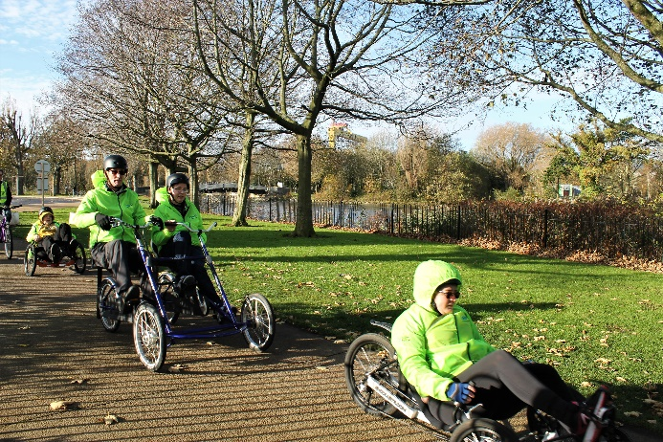
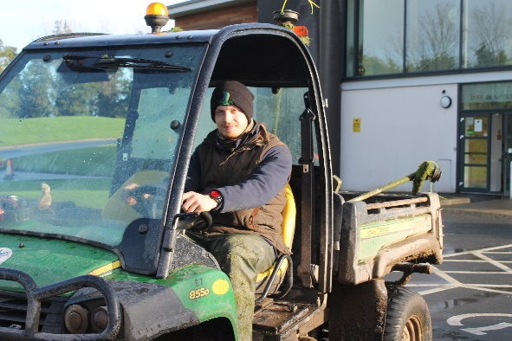
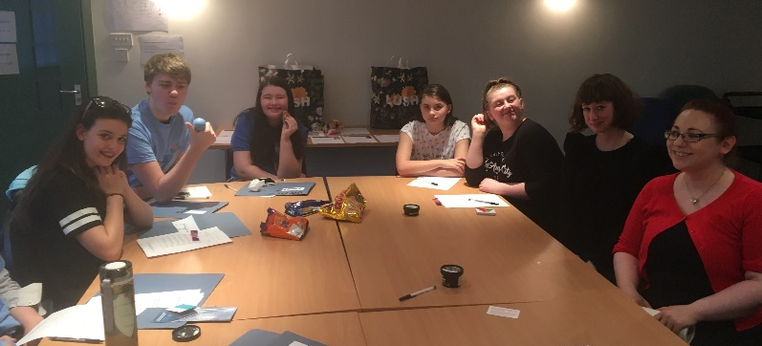
Living Options
Employability and Community Inclusion

Slide 5
Services for Adults and Children with Autism
Increased prevalence in last 10 years, particularly in Children services Transition and Youth Services
Specialist Service Right 4 U☺ developed in 2012
Currently approx. 40% of Service Users with the Employability and CI directorate have a diagnosis of Autism

Slide 6
Right 4 U ☺
BT9 7AS

Slide 7
Right 4 U☺
The Right 4 U 😊 service aims to build and strengthen the capacity of young people and adults with autism to engage in activities within their local communities
Notes:
Established in 2o12 within the Belfast Trust area.. Supporrting young people aged 15-25 years.. Fundamentally a transition service
Referrals to the service comes from the local health Trust ASD Team where the person will have a confirmed diagnosis and are willing to engage in the service

Slide 8
Right 4 U☺
We will assist to
Develop social skills
Reduce social isolation by availing of more social opportunities that are linked to their talents/interests
Develop social networks
Increase independence in daily living and community living skills
Explore daytime opportunities
Identify agencies that can support with access employment opportunities

Slide 9
Right 4 U☺- What’s the difference?
The participants need a higher amount of targeted, individualised support using ASD specific strategies to motivate them to leave the house and re-engage with educational, social and leisure opportunities.
One-to-one support with developing daily living skills and organisational skills is required using visual supports when required.
The opportunity to participate in regular, social activities to increase opportunities for social interactions with peers in a safe environment.
Notes:
So why is this different and specilaised?
Staff employed from Psychology or AHP back ground with experience in working with people with ASD

Slide 10
Right 4 U☺
Key strategies of the service:
The development of a Trusted Relationship between the participant and Project Officer
Development of an Action Plan agreeing the key areas of intervention in partnership
Introduction of appropriate strategies aimed at building confidence so that they feel empowered and motivated to engage in activities outside the family home.
Support the young person to engage in selected activities tailored to the needs and interests
Ongoing review of progress including signposting
Notes:
Getting to know you sessions were the most frequent with both sets of participants and involved visits to the family to meet with the young persons and with their parents; usually the mother. From these a personalised action plan was developed and regularly reviewed. This is the core work of the project aimed at boosting the young people’s confidence and their personal development. Preparatory work is often done at home before new skills can be modelled out in the community
This includes regular meetings of around 60 minutes or contact by phone or social media to build confidence and independence and work towards modeling new skills in the community environment
Education related activities were the next most common with most participants. These included visiting colleges, career officers, obtaining prospectus and making application for funding. These activities tended to show a decline over the quarters as the young people actions were met and courses have started.
Leisure activities were more common with young adults but increased for children in the later quarters. The figures are somewhat inflated by the organisation of social events such as ten-pen bowling and cinema
The worker will sign-post the young person to opportunities and support services and assist them in their initial contacts with the agencies

Slide 11
Right 4 U☺
Evaluation of Right 4 U☺ took place in 2014 ( Belfast Trust area) Transition Service (16-25)
“Right4U has a crucial role in helping young people make the transition into adulthood by equipping them with independence skills and helping network them into their local community. Many young people with autism typically fall between the mental health and learning disabilities teams often resulting in neither team taking responsibility for the young person in transition but Cedar is now
providing an important service to this overlooked group”
Health Trust Staff
Notes:
Significant improvements in

Slide 12
Right 4 U☺
“While I felt I was often challenged to go outside my comfort zone by the project through trying new things etc., I always felt supported and encouraged when findings things difficult and wasn’t pushed into things I felt I couldn’t manage. It has helped me to become more independent and feel more capable of facing challenges”
(Young Person)
“Sometimes I am so afraid for my son and his future. Will he continue on in school? Will he get a job and make friends? The Right4U project gives me hope and helps me believe that anything is possible. He is being given the chance to be himself and that means the world to me.” (Parent)

Slide 13
Thank You

